Slide 1
Harness the Power of Illumination with External LED Blinking

Slide 2


LIST OF COMPONENTS:
ESP32 MICROCONTROLLER
LED
JUMPER WIRES
BREAD BOARD

Slide 3
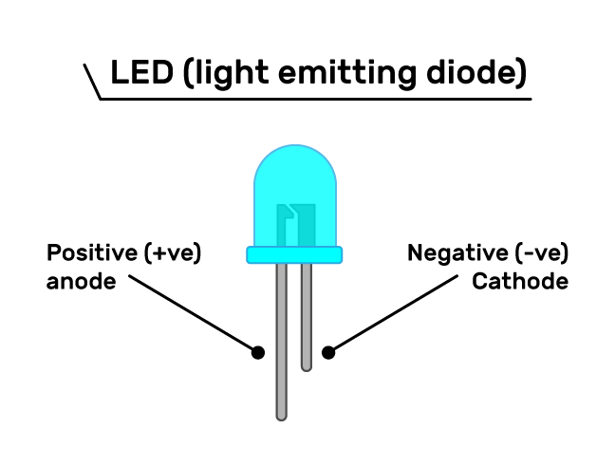
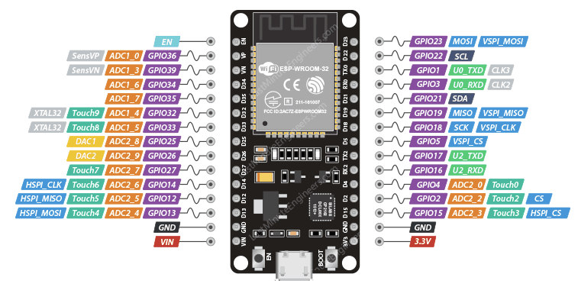
CIRCUIT DIAGRAM:
ANODE-PIN 2
CATHODE-GND

Slide 4
CODE:
const int ledPin=2;
void setup()
{
Serial.begin(9600);
pinMode(ledPin,OUTPUT);
}
void loop()
{
digitalWrite(ledPin,HIGH);
delay(2000);
digitalWrite(ledPin,LOW);
delay(2000);
}

Slide 5
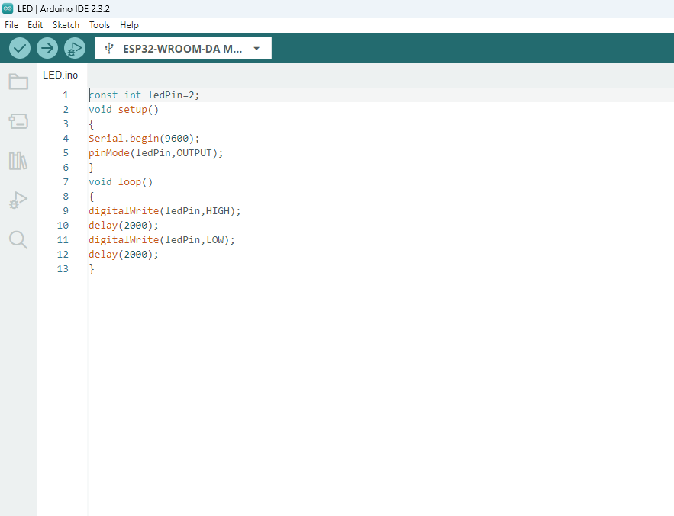
STEP 1
Copy code paste in Arduino new Sketch

Slide 6
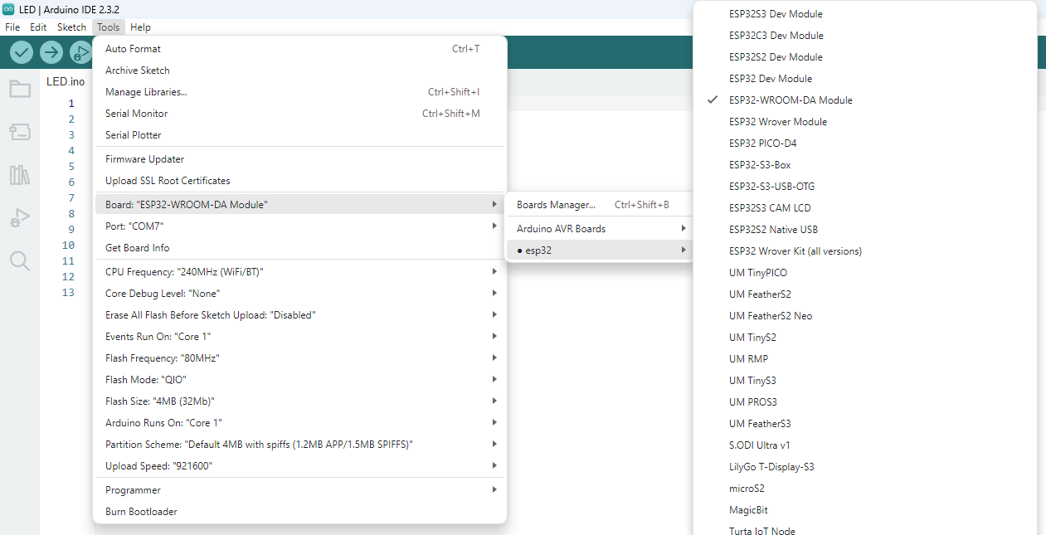
STEP 2
Board---->esp32---->esp32-wroom-DA module

Slide 7
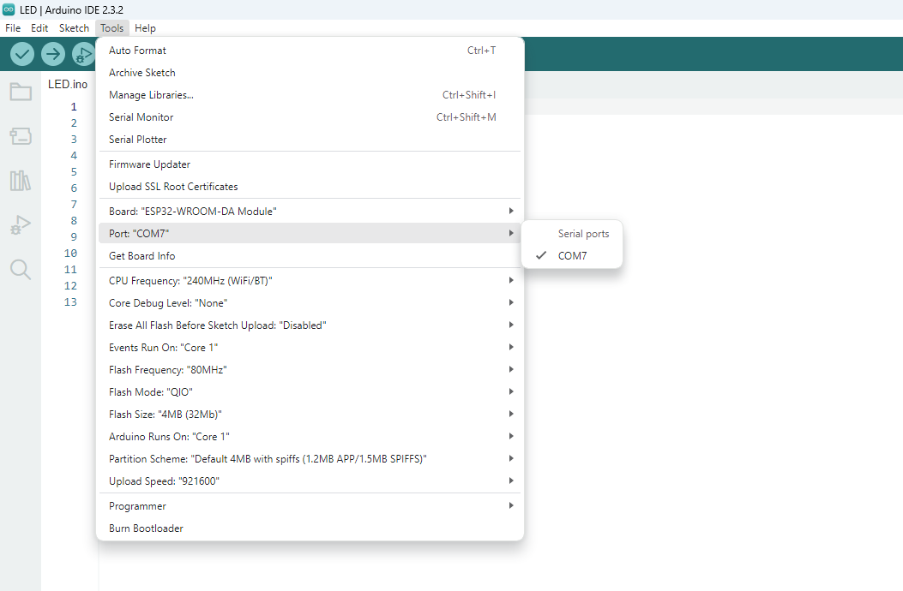
STEP 3:
Tools---->port---->select your com

Slide 8
board name automatically change to dark

Slide 9
2.After Compilation build the code to board
1.Compile the code

Slide 10
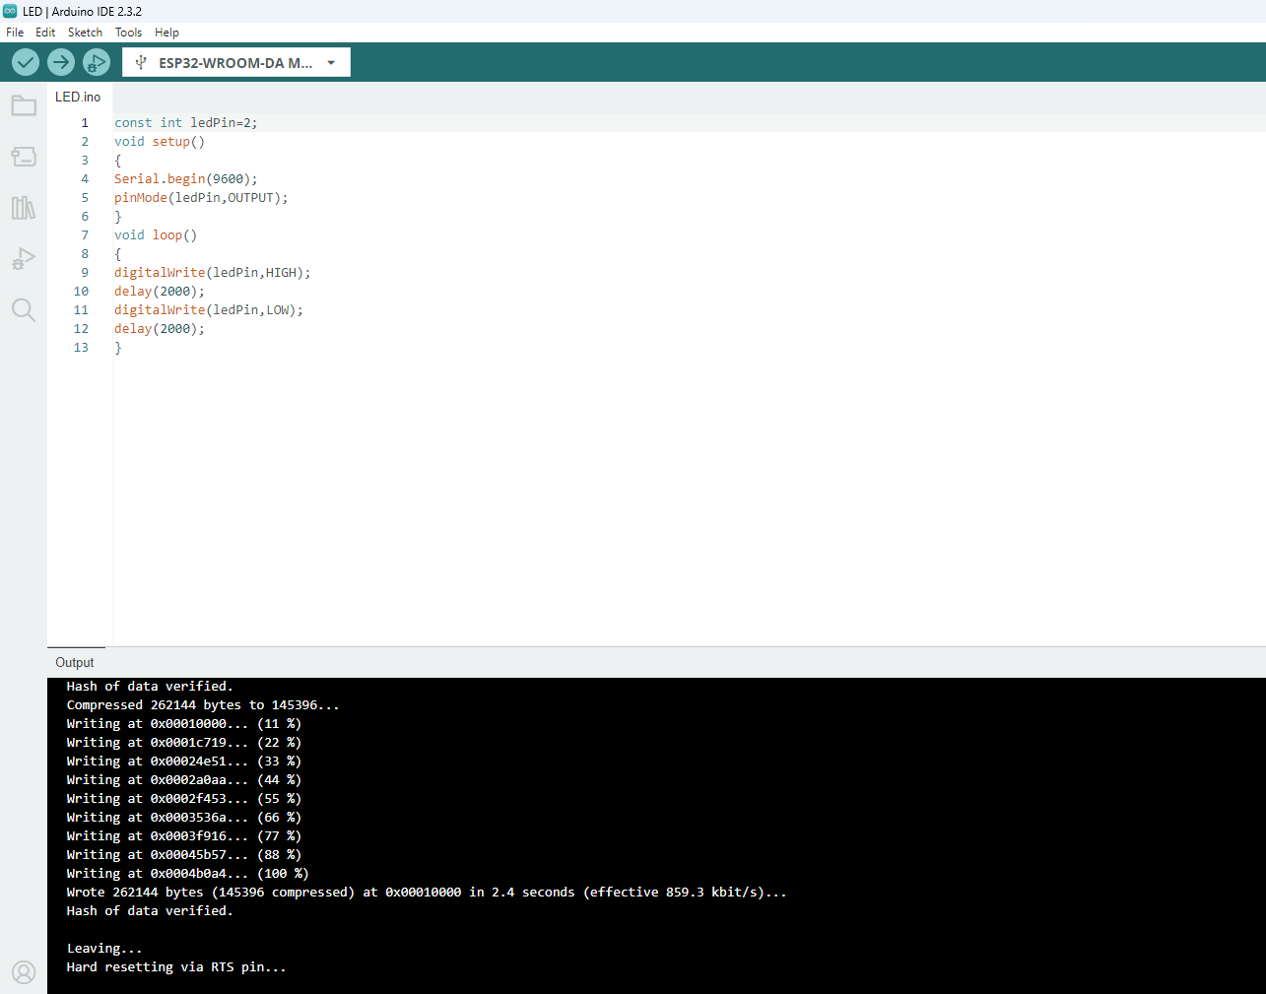
After Build the code the output like this

Slide 11
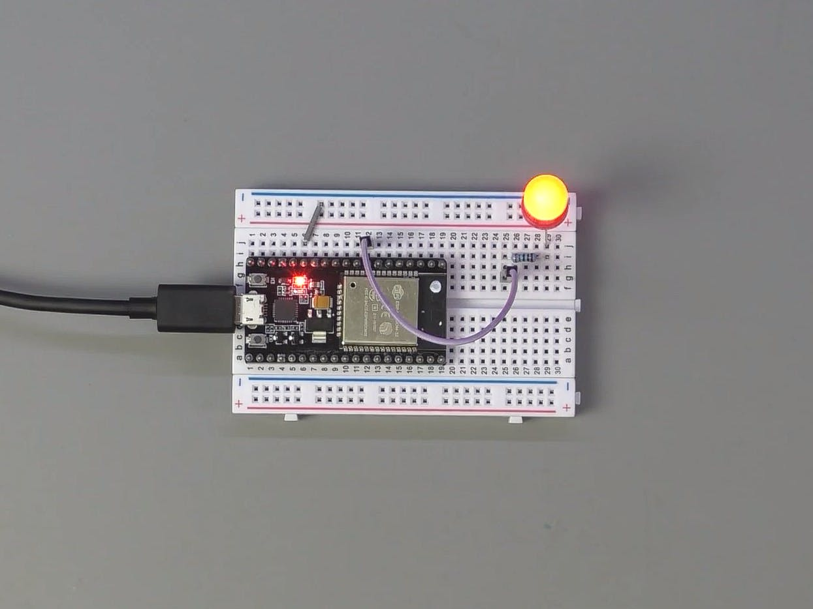
OUTPUT:
When we upload the code the led will blink

